Slide 1
How to Install
Back-End ( Bookshelf , Knex , Postgres )
NB: use chrome browser and install the “Access-control-allow-cross-origin” for the app store(green button in top right of chrome window should appear)
Postgres Set-Up => Create Database in Postgres “ Jobwebsite_db”
Dummy Database data Set-up => knex migrate:lastest (\chaluutali\jobsite\jobsite) in the command line
Install => npm install;
Run back-end => npm start;

Slide 2
Front-end ( React js , Redux js , Node express js )
Install => npm install ;
Run => npm start; (\chaluutali\jobsite\jobsite\client ) in command line
Happy Testing ☺

Slide 3
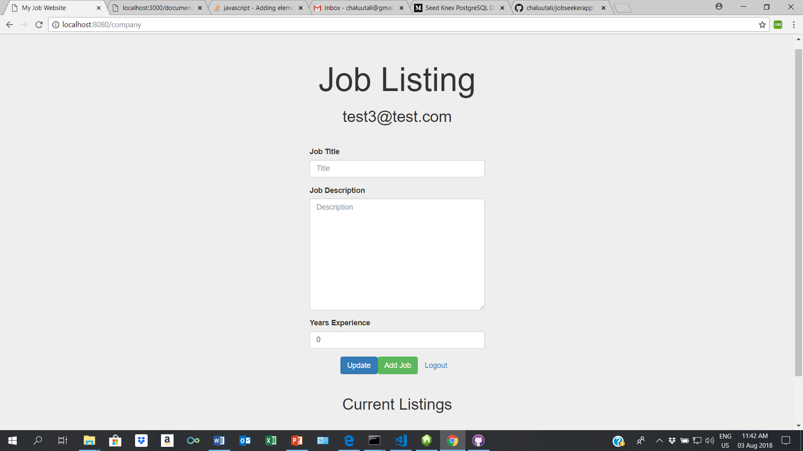

Slide 4
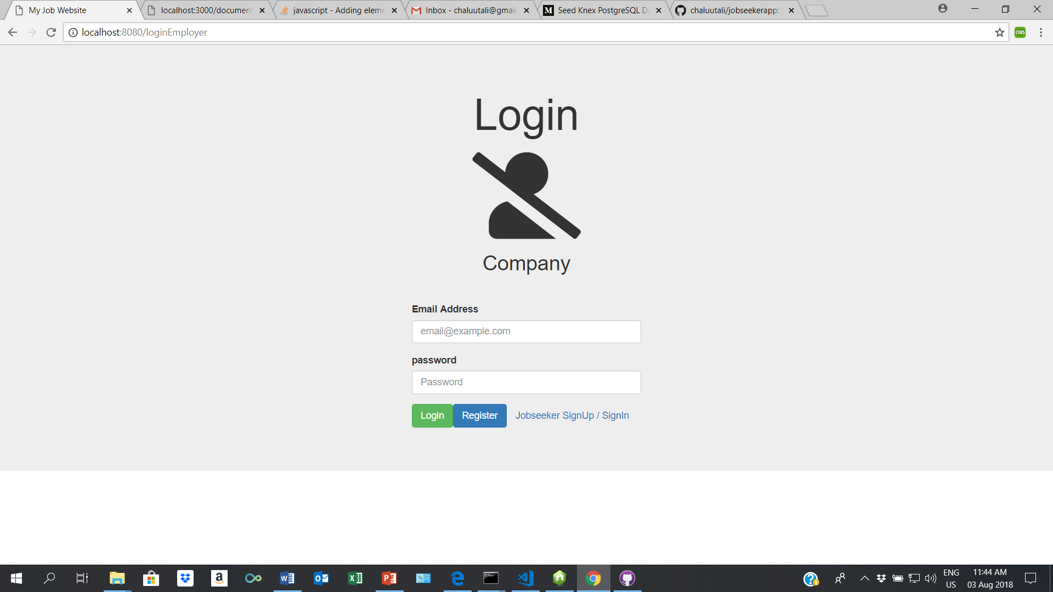

Slide 5
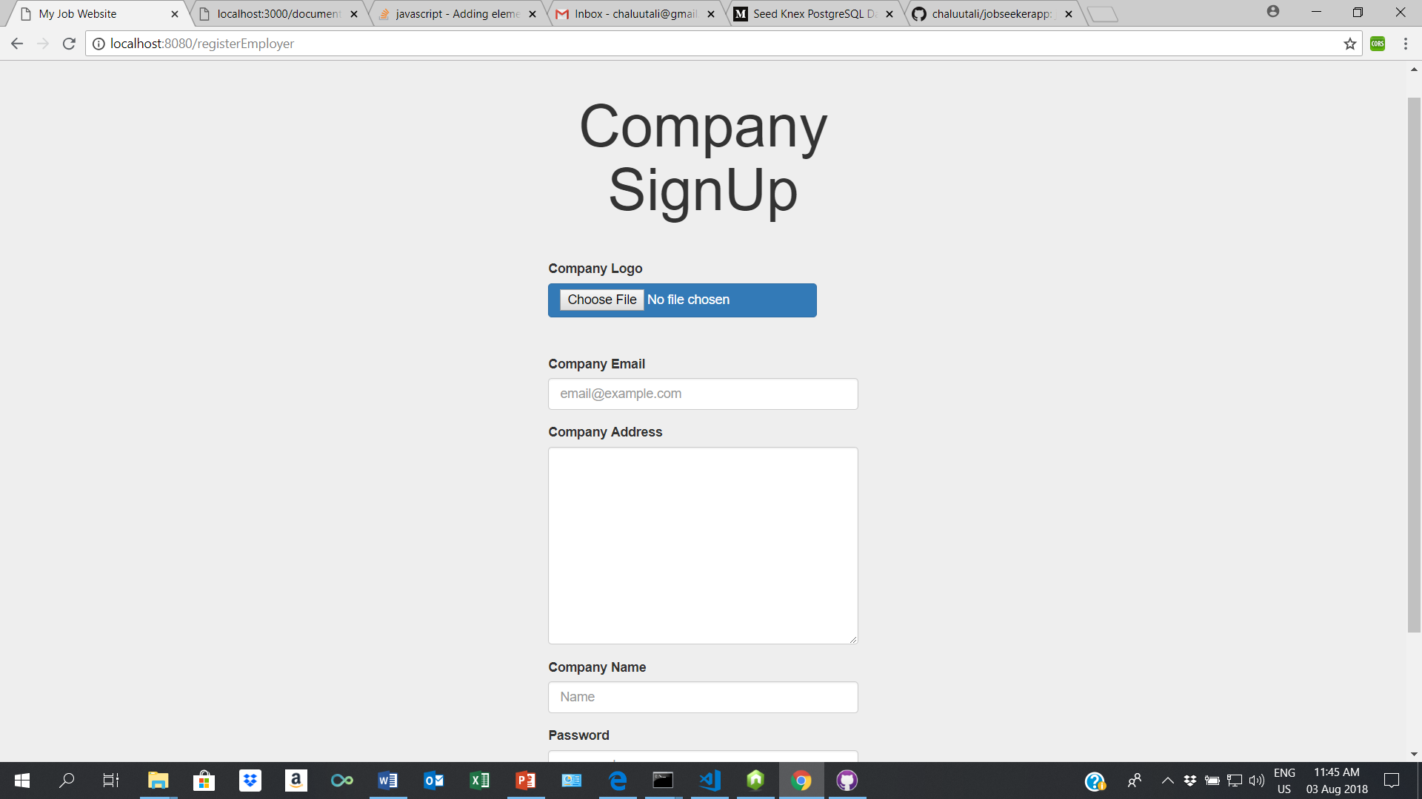

Slide 6
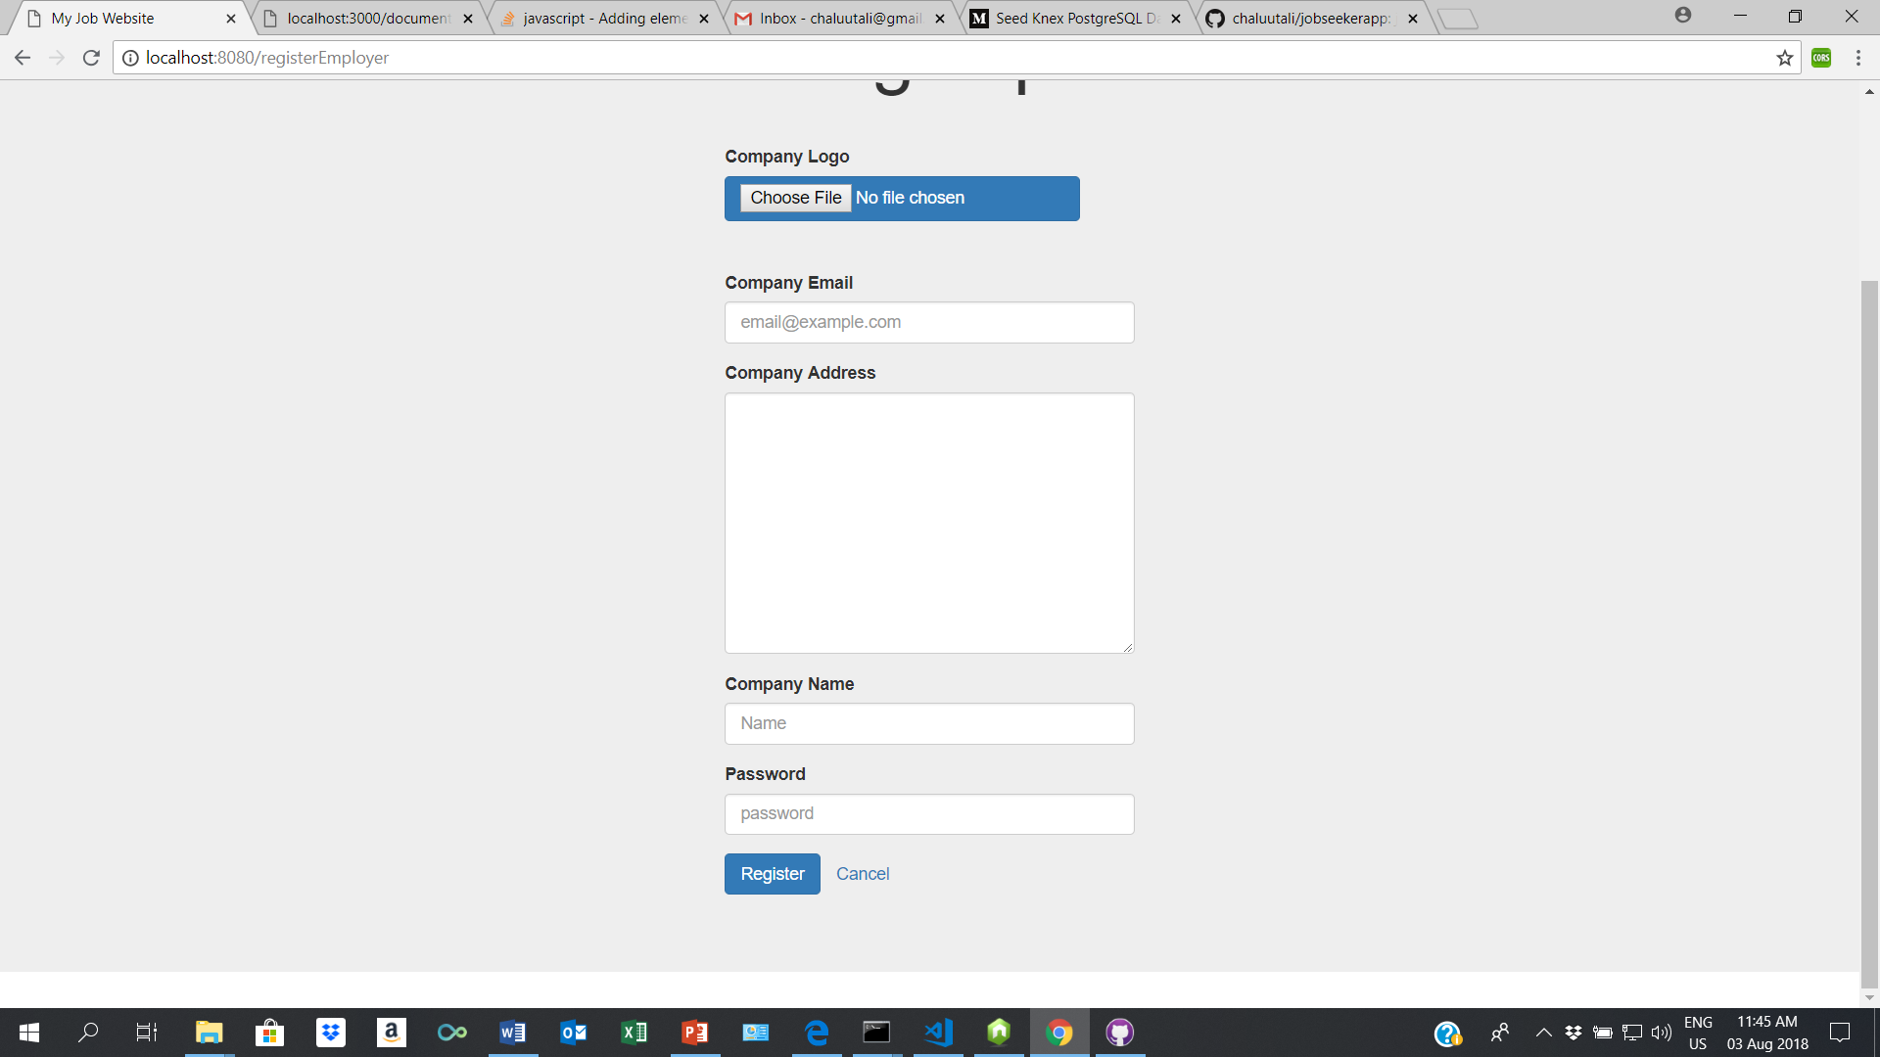

Slide 7


Slide 8
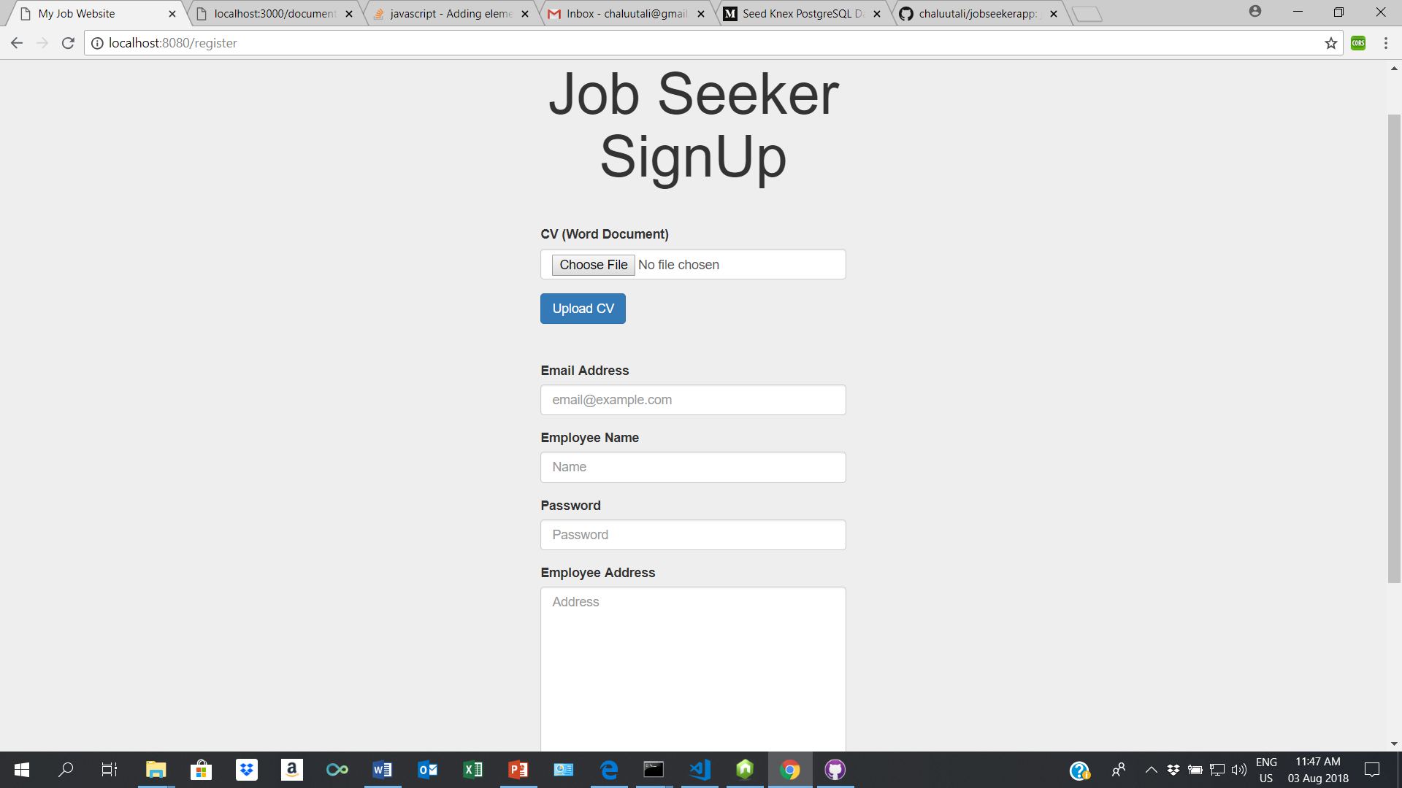

Slide 9
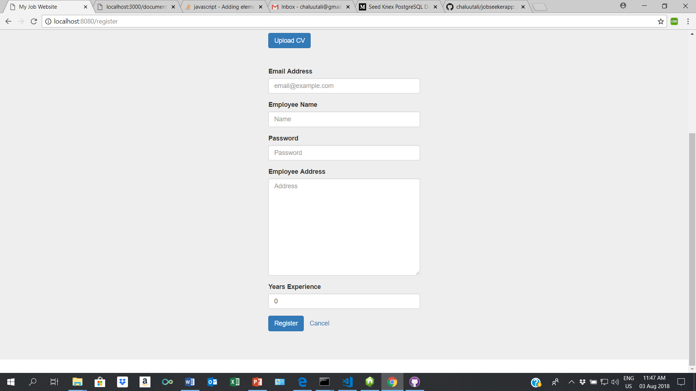

Slide 10
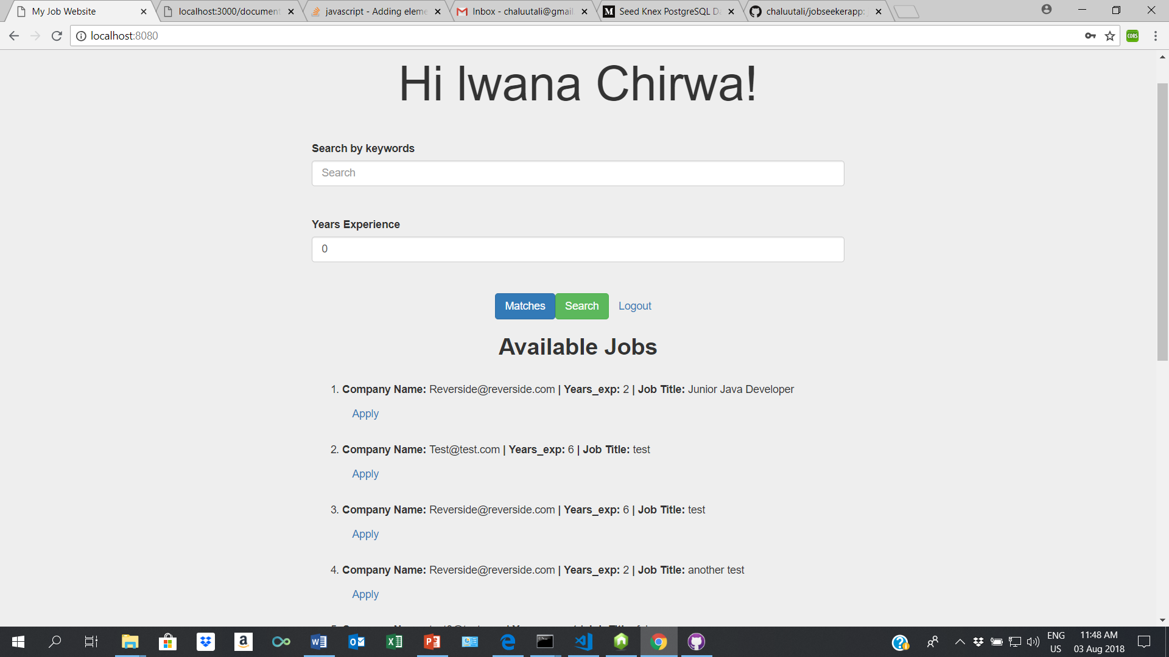

Slide 11
